Slide 1
Unit -5
Advanced energy systems
Syllabus
Battery technology: Introduction to Electrochemistry, characteristics of battery, Lithium-Ion battery, metal air battery. Battery technology for e-mobility: Super capacitors: Storage principle, types (EDLC, pseudo and hybrid) with examples and applications. Photovoltaics: organic/inorganic solar cells, quantum dot sensitized (QDSSC’s). Photo catalytic water splitting
‹#›

Slide 2
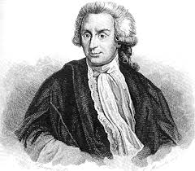
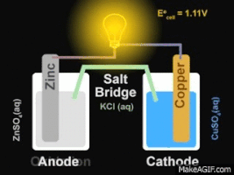
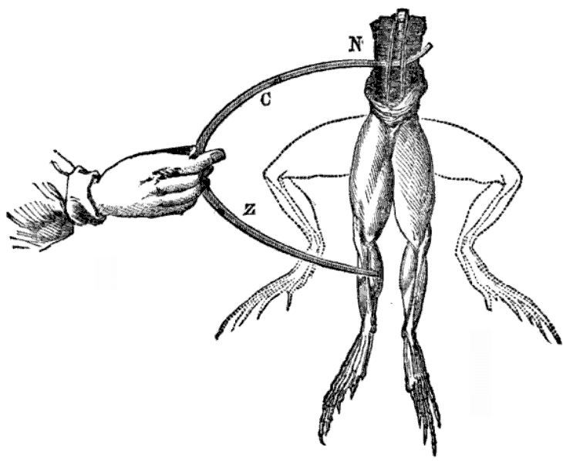
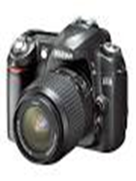
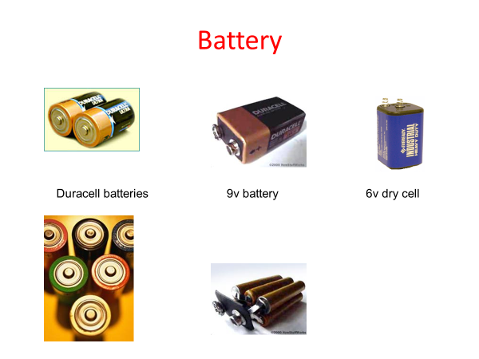


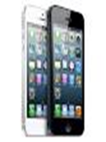

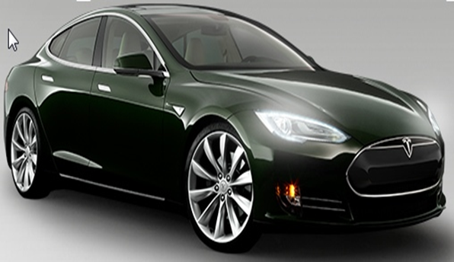
Modern Electro chemistry- Introduction
Luigi Galvani
Galvanic Cell
Animal Electricity!!!

Slide 3
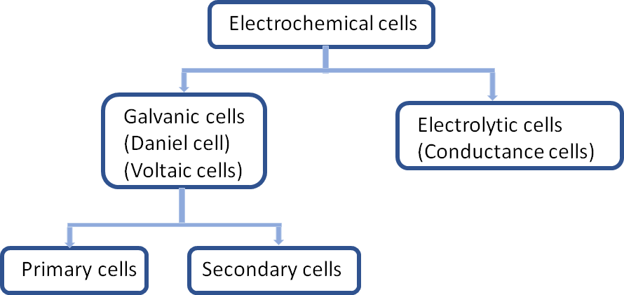
Types

Slide 4
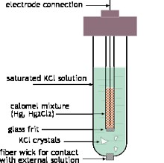
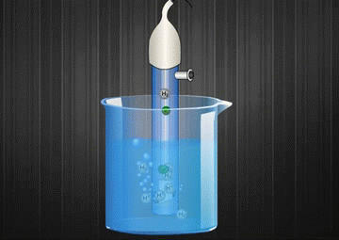
Types of Electrodes
1. Metal-Metal Ion electrode
Example: Zn/Zn^{2+//} Cu/Cu²⁺
2. Metal-Metal salt ion electrodes
Example: Calomel electrode Hg/Hg₂Cl₂/Cl⁻
Silver- Silver chloride electrode Ag/AgCl(s)/Cl⁻
4. Oxidation –Reduction electrodes:
Example: Pt/Fe²⁺, Fe³⁺,
Pt/Sn²⁺, Sn⁴⁺
5. Ion selective electrode:
Ex: Glass electrode
3. Gas electrode:
Example: Standard hydrogen electrode Pt/H₂ (g) (1atm)/ H⁺

Slide 5


Go, change the world
RV College of
Engineering
Fundamentals of battery technology
Battery Chemistry
The ideal battery does not yet exist
‹#›

Slide 6
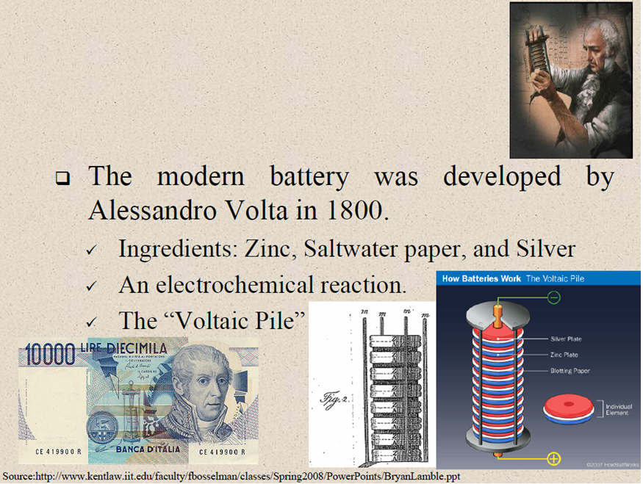
Battery History
‹#›

Slide 7
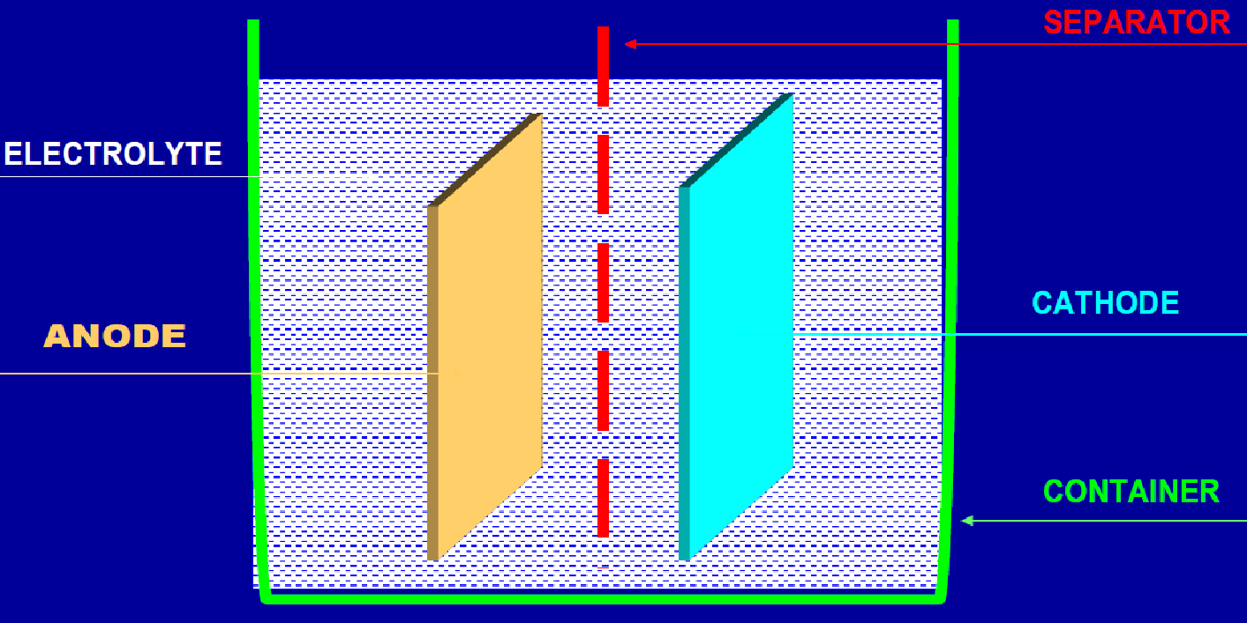
Cell construction and cell reaction
ANODE REACTION: is an oxidation reaction which releases electrons (Anode is the –ve electrode in EC cell)
CATHODE REACTION: is a reduction reaction which consumes electrons (Cathode is the +ve electrode in EC cell)
ELECTROLYTE is an ion-conducting medium which conducts ions between the electrodes so that the
above reactions can take place
‹#›

Slide 8
CLASSIFICATIION OF BATTERIES
PRIMARY BATTERY
Non-rechargeable (cell reactions are irreversible) - Self-discharges whether used or not
LECLANCHE CELLS (Zn/C) - Popular low-cost system, Applications: Torch light, portable radios, toys, novelties, etc.
Mg/MnO₂ CELLS - High capacity system: Applications: Military communication
equipment, voting machines, etc.
SECONDARY BATTERY
Rechargeable (cell reactions are reversible),
Lead-Acid Battery (Pb/H⁺), Nickel-Cadmium Battery (Ni-Cd), Nickel-Iron Battery (Ni-Fe), Nickel-Metal hydride Battery (Ni-MH)
Lithium battery (Li-LiM_{x}O_{y}), ithium-Ion battery (C-LiM_{x}O_{y}),Lithium-Ion Polymer Battery (C-LiM_{x}O_{y})
RESERVE BATTERY
one of the cell components, usually the electrolyte, is kept isolated from the rest and
is added at the time of need
Mg/Cu₂Cl₂, Mg/AgCl (sea water activated battery), Applications: Torpedoes, Sea beacons (Mainly in Meteorology and Defense fields)
Li/FeS2 (Thermally activated battery) Applications: In Missiles
‹#›

Slide 9
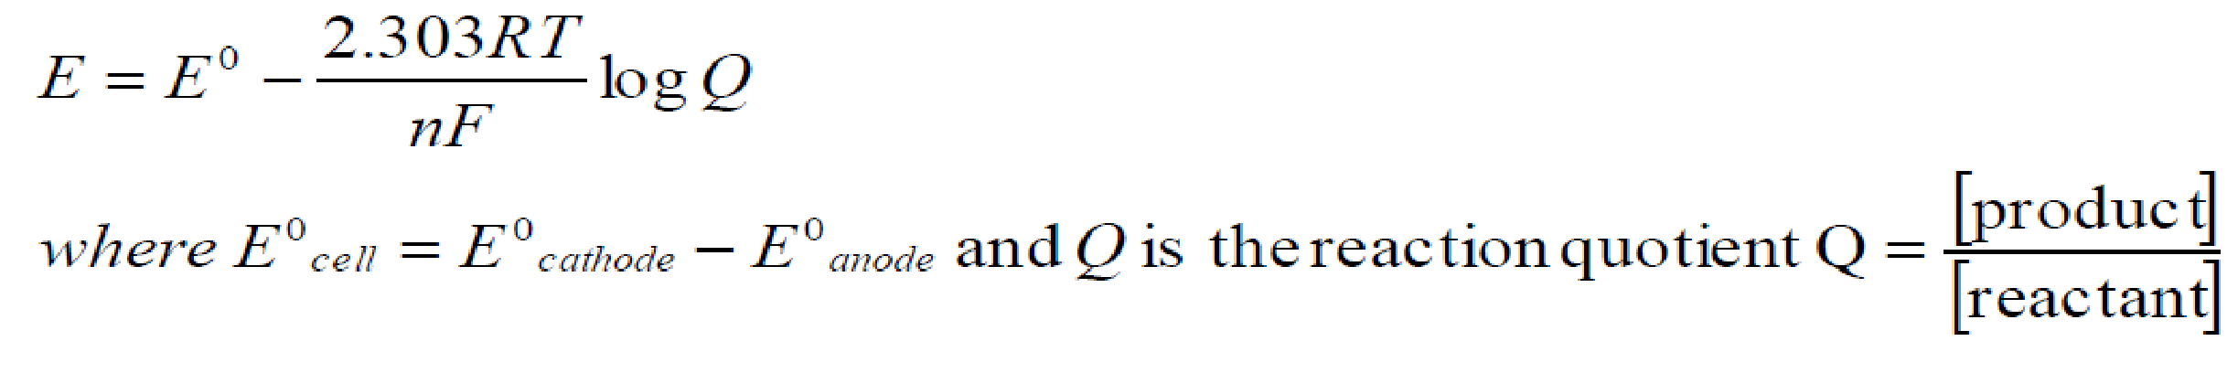
Battery Characteristics
Voltage: The voltage of a battery mainly depends upon the emf of the cells which constitute the battery system. The emf of the cell depends on the free energy changes in the overall cell reaction. As given by Nernst equation,
‹#›

Slide 10
Battery Characteristics Contd..
Current: Current is a measure of the rate at which the battery is discharging. • Higher the rate of spontaneous reaction, higher is the current. •Higher the surface area of the electrodes, higher is the rate of reaction. •Current is measured in A.
Capacity: Capacity is a measure of the amount of electricity that may be obtained from the battery. It is expressed in Ah (ampere hours). It is proportional to the amount of charge in Coulombs that may be transported from anode to cathode through the external circuit. The charge (C) in Coulombs is given by the Faraday’s relation:
Where, C is Capacity of battery (in Ah)
W is Weight of the active material
n is number of electrons involved in discharge reaction
F is Faradays constant, 96500 C/mol
M is Molar mass.
‹#›

Slide 11
Battery Characteristics Contd..
Electricity storage density: It is the amount of electricity stored in the battery per unit weight of the battery. • i.e. it is the capacity per unit weight.
•It can be expressed in Coulombs/kg or in Ah/kg. The weight includes
the weight of all components of the battery (i.e. total weight of active
material, electrolyte, terminals etc.)
Energy efficiency: The energy efficiency of a rechargeable battery
is given by
‹#›

Slide 12
Battery Characteristics Contd..
•Cycle Life: Primary batteries are designed for single
discharge and secondary batteries can be chargeable again
and again. The number of charge and discharge cycles that are possible in secondary batteries, before failure occurs is called cycle life. The cycle life of batteries must be high for secondary batteries.
• Shelf life: The duration of storage under specified
conditions at the end of which a cell or a battery retains its
ability to work or to produce energy is called shelf life. A good battery should have more shelf life.
‹#›

Slide 13
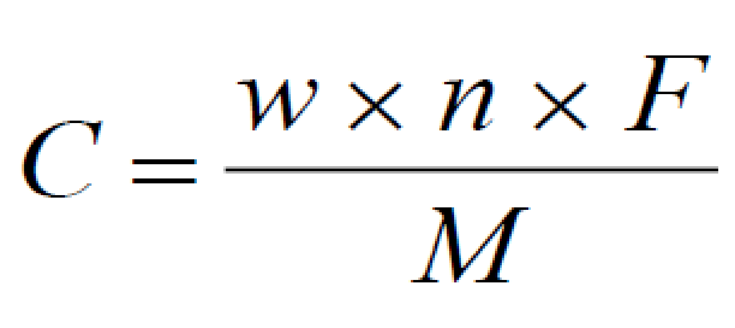
Problems on Battery Characteristics
‹#›

Slide 14
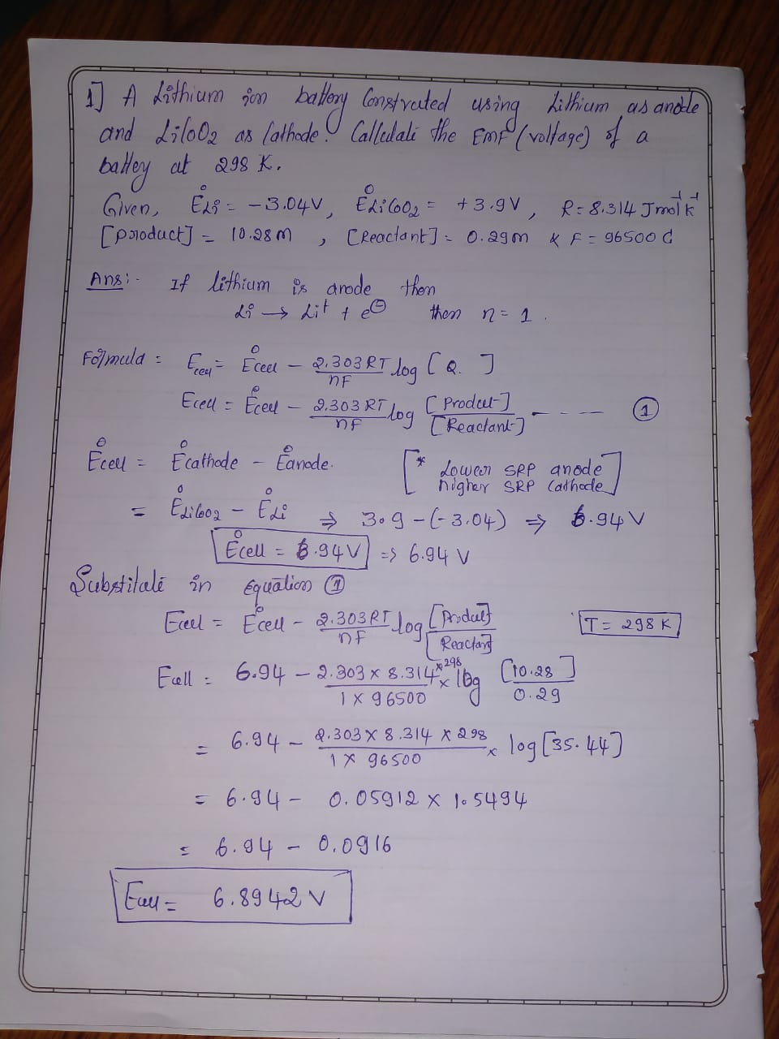
‹#›

Slide 15
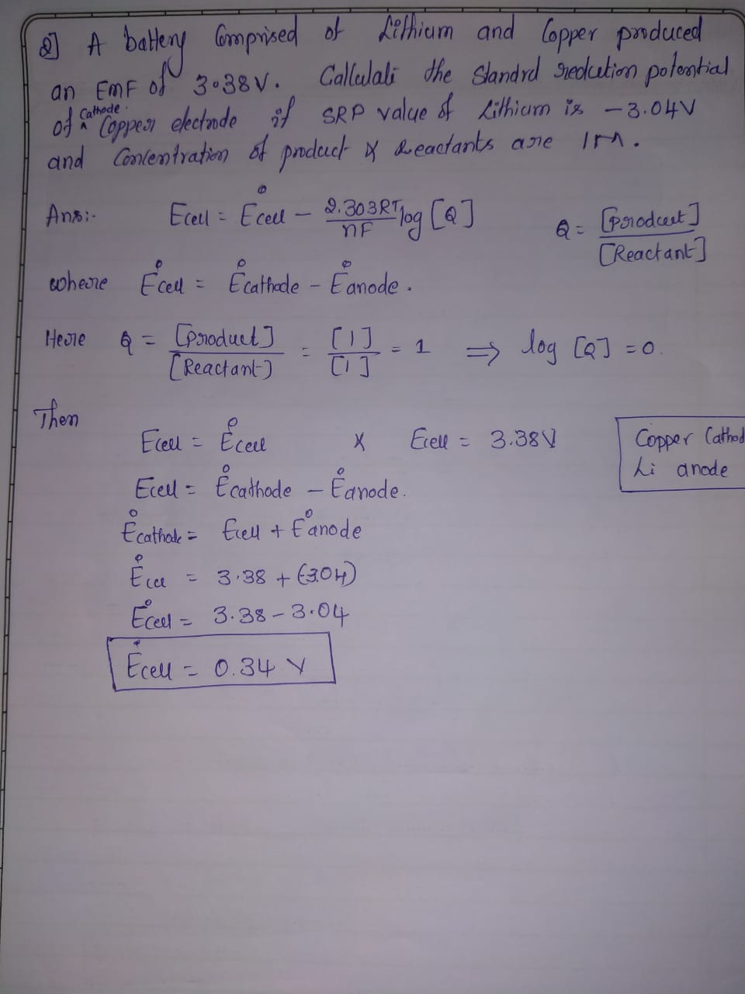
‹#›

Slide 16
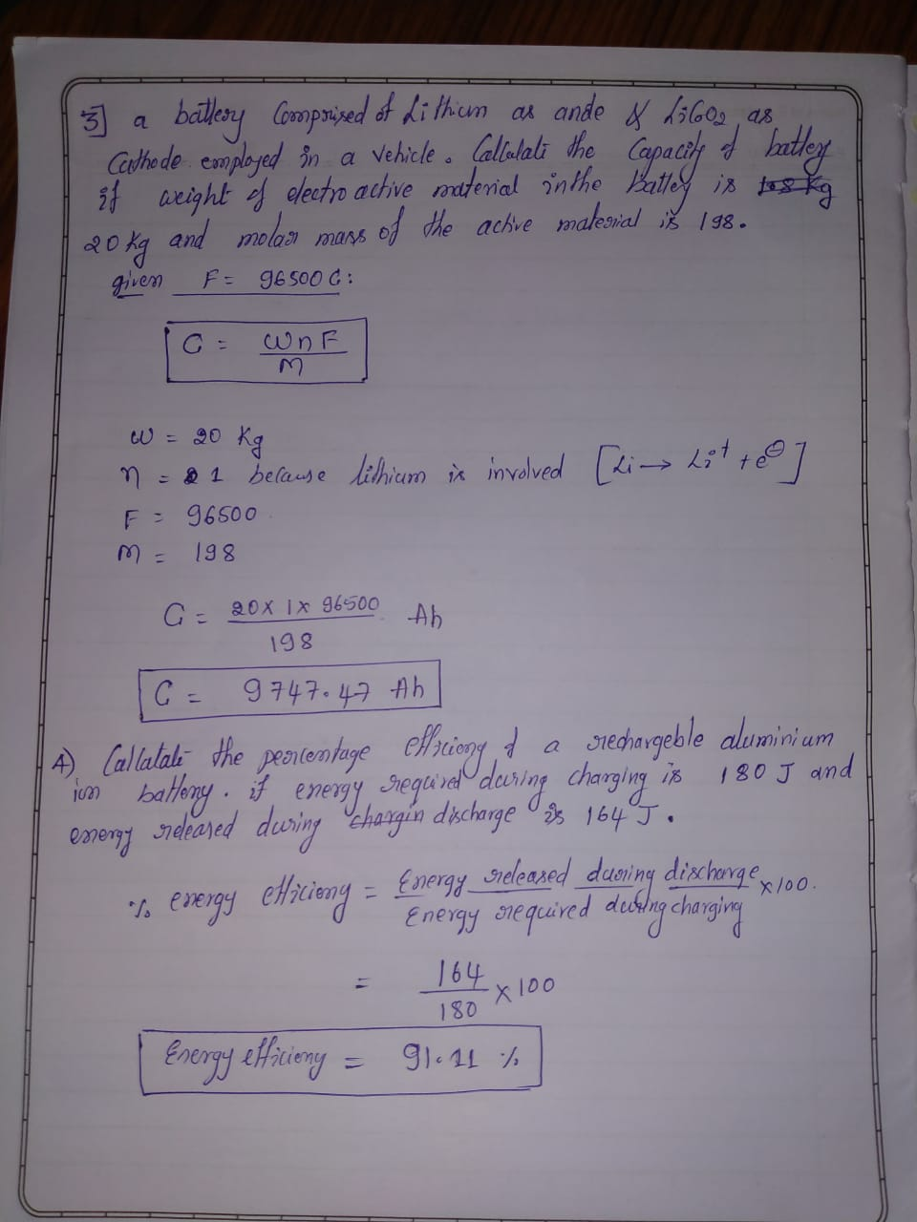
‹#›

Slide 17
‹#›

Slide 18
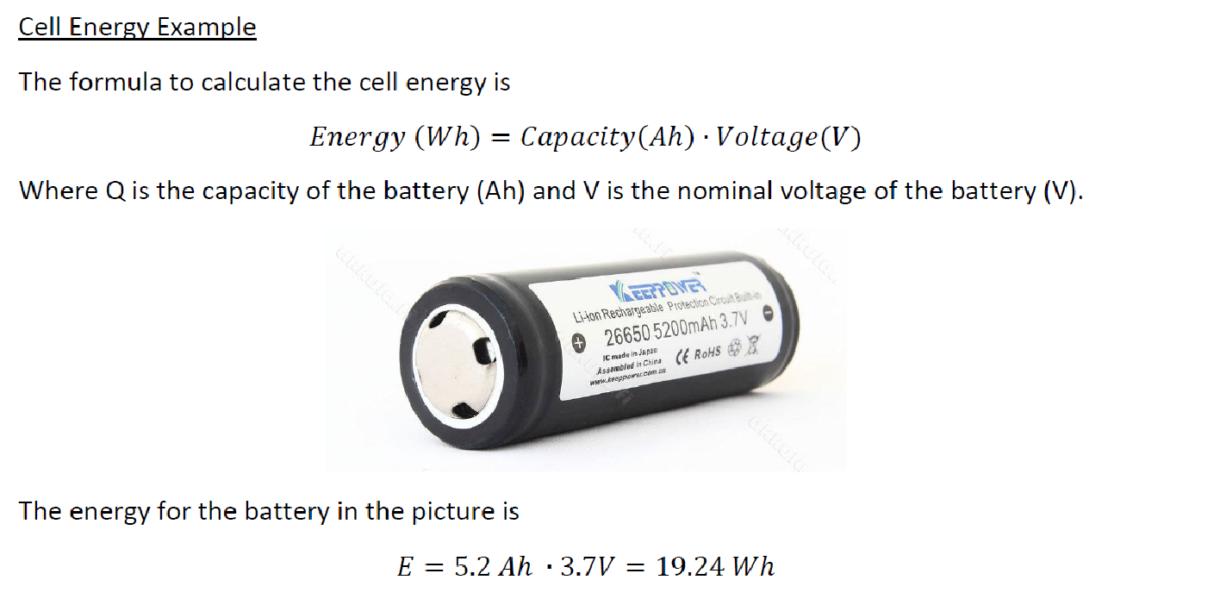
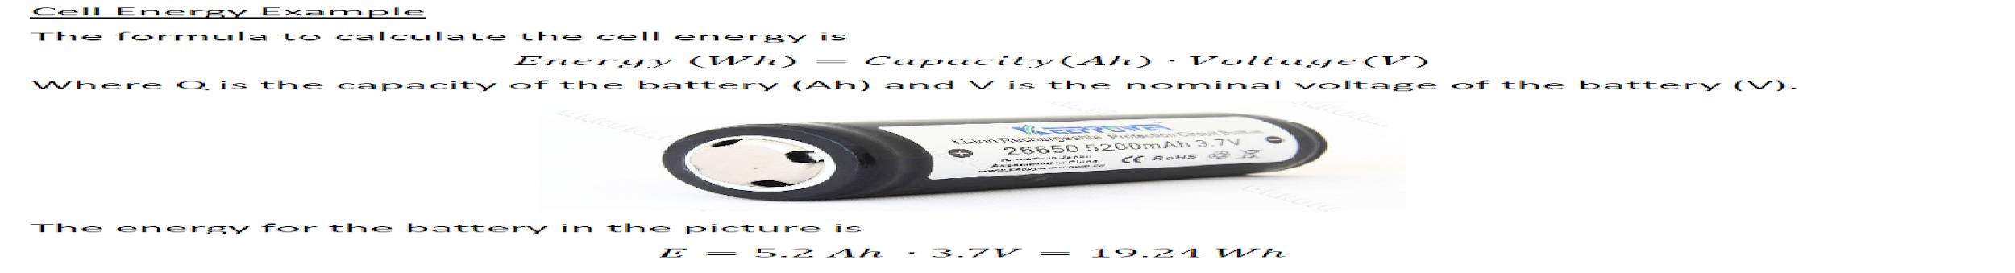

Problem 5 Calculate the energy of the following battery
‹#›

Slide 19
Anode materials
Desired characteristics of anode materials
1) Large capability of Lithium adsorption
2) High efficiency of charge/discharge
3) Excellent cyclability
4) Low reactivity against electrolyte
5) Fast reaction rate
6) Low cost
8) Environmental -friendly, non-toxic
 Commercial anode materials:
Hard Carbon, Graphite
‹#›

Slide 20
Cathode Materials
Desired characteristics of Cathode materials
High discharge voltage
High energy capacity
Long cycle life
High power density
Light weight
Low self-discharge
Absence of environmentally hazardous elements
 Commercial cathode materials:
LiCoO₂, LiMn₂O₄, LiNiO₂, LiFePO₄
‹#›

Slide 21
Electrolytes
⚫ Role of electrolyte
1) Ion conductor between cathode and anode
2) Generally, Lithium salt dissolved in organic solvent
3) Solid electrolyte is also possible if the ion conductivity is high at
operating temperature.
⚫ Characteristics of Electrolyte
1) Inert
2) High ionic conductivity, low viscosity
3) low melting point & high dielectric constant (ε)
4) Appropriate concentration of Lithium salt
5) Chemical/thermal stability, High flash point (Tf), nontoxic,
6) Low cost
7) Environmental -friendly, non-toxic
⚫ Commercial electrolytes: LiPF₆ in Carbonate solvent, propylene carbonate, 1,2 dimethoxy ethane
‹#›

Slide 22
Types of Electrolytes
1) Liquid electrolyte: LiPF₆ in 1,2, dimethoxy ethane
2) Molten lithium salt: LiCl, LiBr etc
3) Amorphous Polymer Electrolytes: Lithium salts in Propylene carbonate
4) Crystalline Polymers:
Electrolyte additives
1) Those used for improving the ion conduction
properties in the bulk electrolytes
2) Those used for SEI chemistry modifications
3) Those used for preventing overcharging of the cells
‹#›

Slide 23
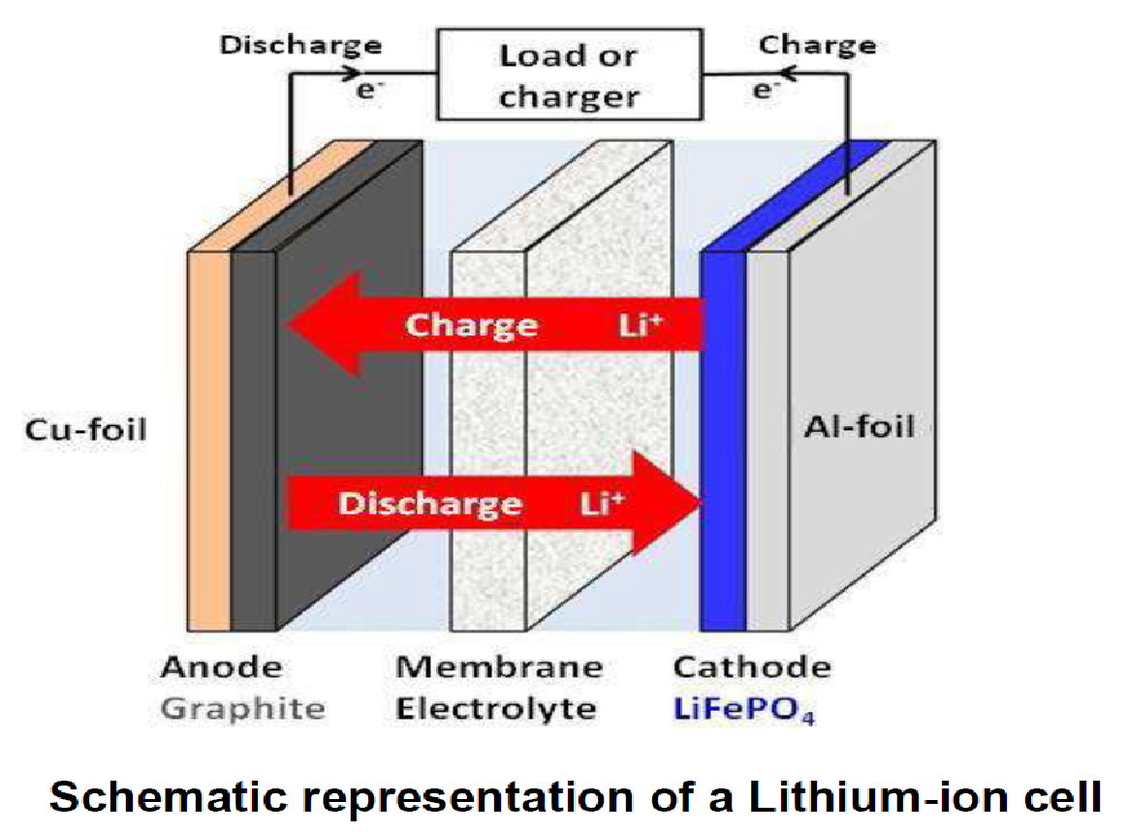
Construction and working of Li-ion batteries
‹#›

Slide 24
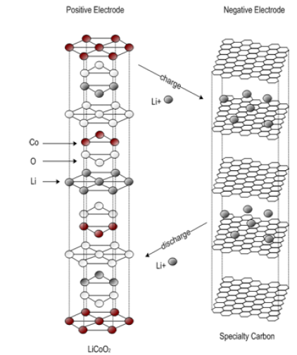
Construction and working of Li-ion batteries
Positive electrode: Lithiated form of a transition
metal oxide (lithium cobalt oxide-LiCoO₂ or
lithium manganese oxide LiMn₂O₄)
Negative electrode: Carbon (C),
usually graphite (C₆)
Electrolyte: solid lithium-salt electrolytes
(LiPF₆, LiBF₄, or LiClO₄)
and organic solvents (ether)
‹#›

Slide 25
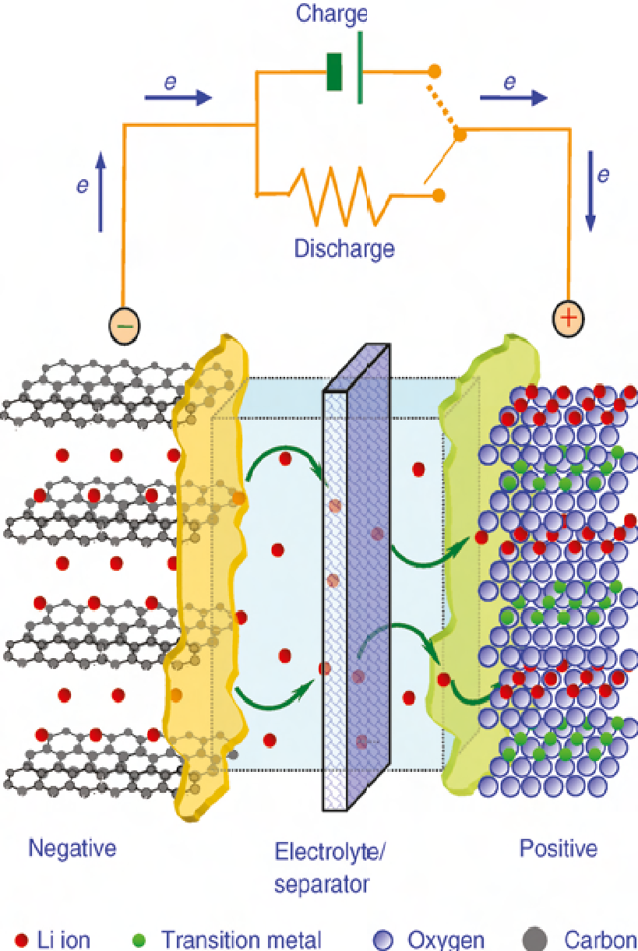
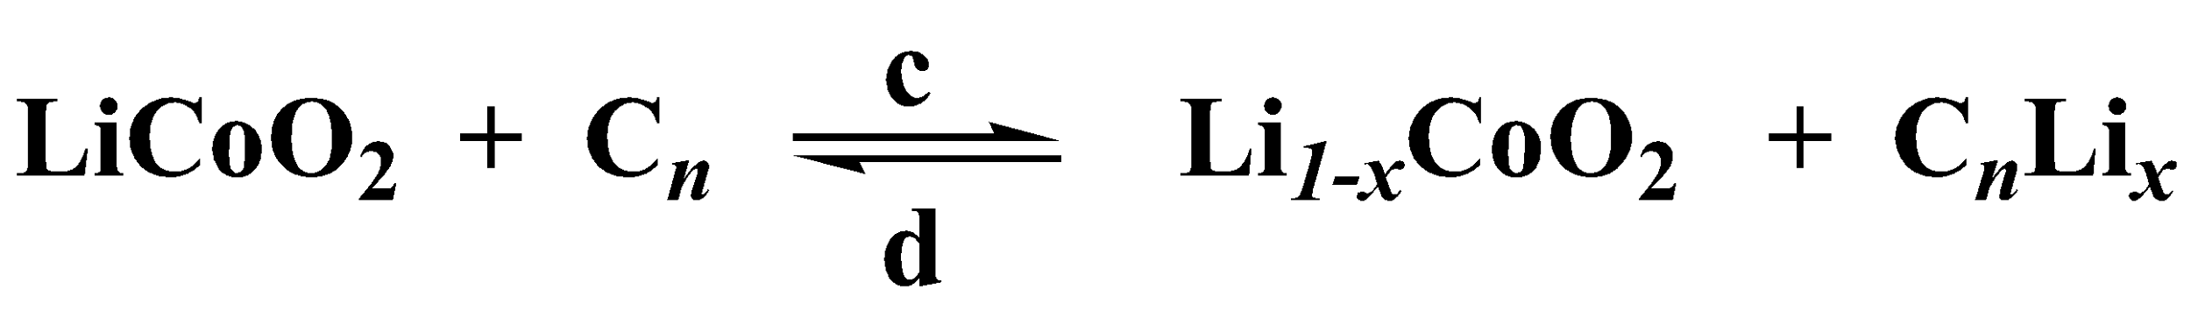
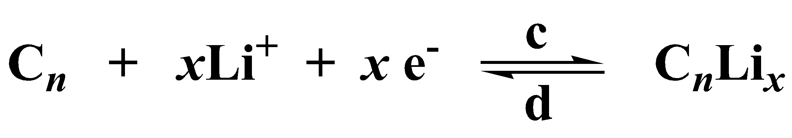
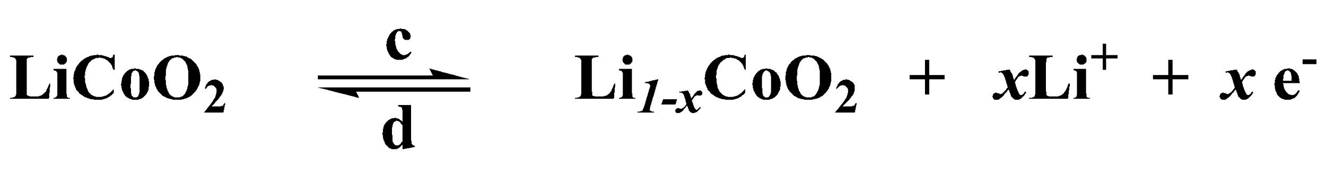
Li-ion battery system
Electrochemical Reactions
Cathode
Anode
Overall
‹#›

Slide 26
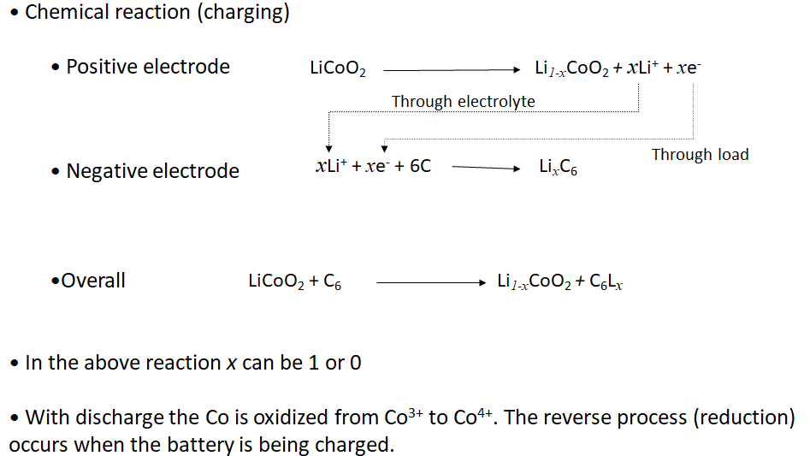
Cell reaction/Working of Li-ion batteries

Slide 27
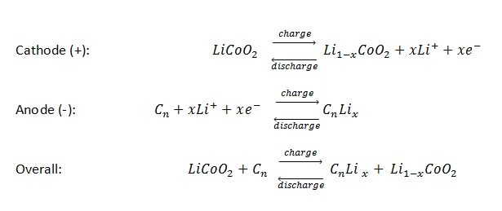
Charging and discharging reactions
‹#›

Slide 28
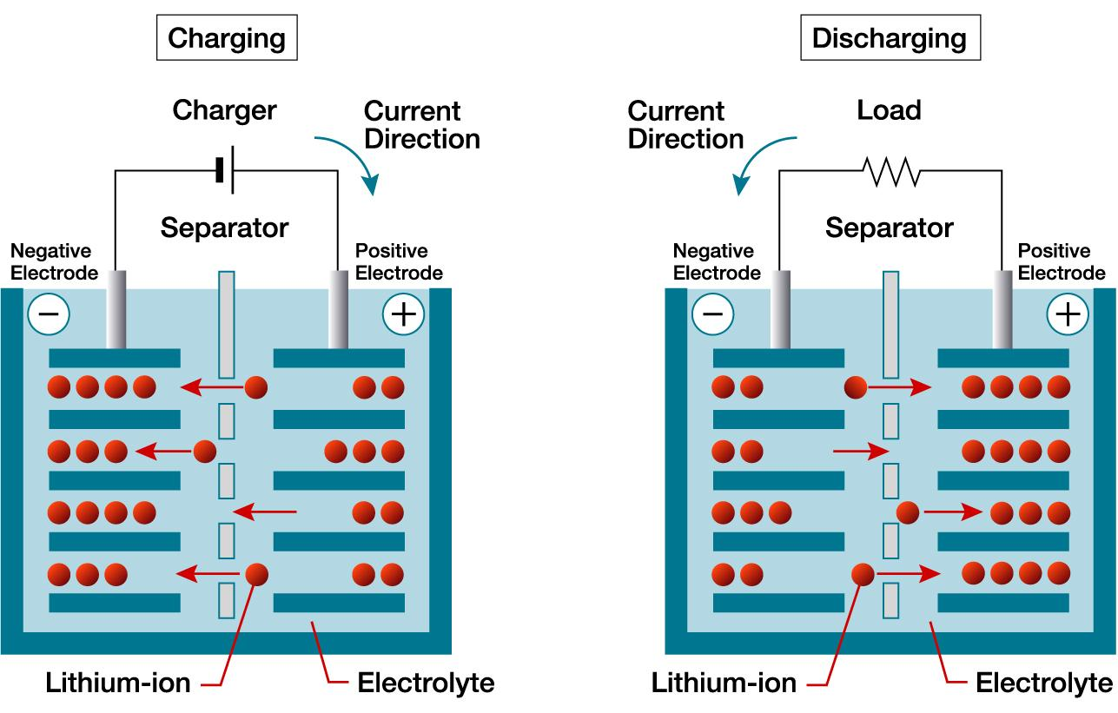
Charging and discharging reactions
‹#›

Slide 29
‹#›

Slide 30
Super capacitor
‹#›

Slide 31
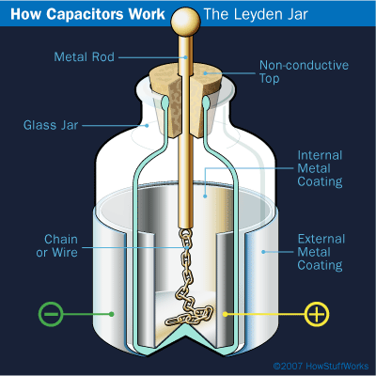
History of Capacitors
In 1740, Ewald Georg von Kleist constructed the first capacitor.
In the same year Pieter von Musschenboek invented the Leyden Jar.
Ben Franklin soon found out a flat piece of glass can be used in place of the jar model

Slide 32
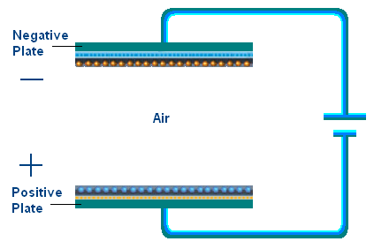
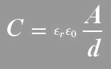
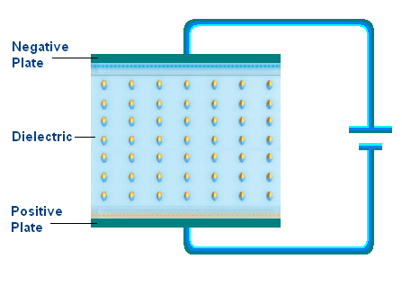
Capacitors
Two parallel plates with dielectric in between
Capacitance limited by flat surface area and dielectric properties
C is the capacitance
A is the area
εr is the relative static permittivity (dielectric constant)
εo is the permittivity of free space (8.854x10-12 F/m)
d is distance

Slide 33
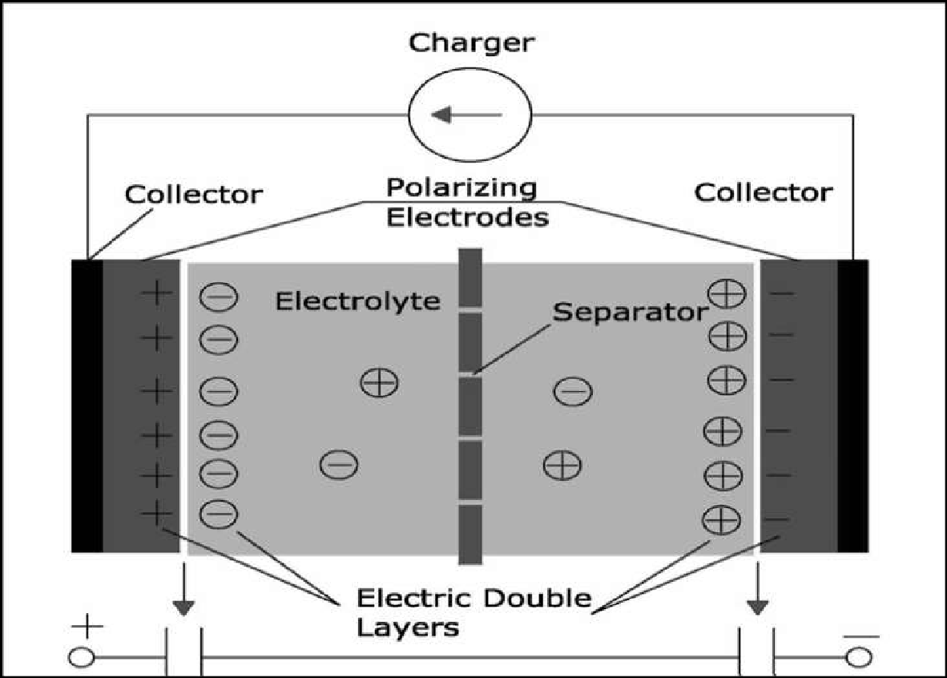
Introduction to super capacitors

Slide 34
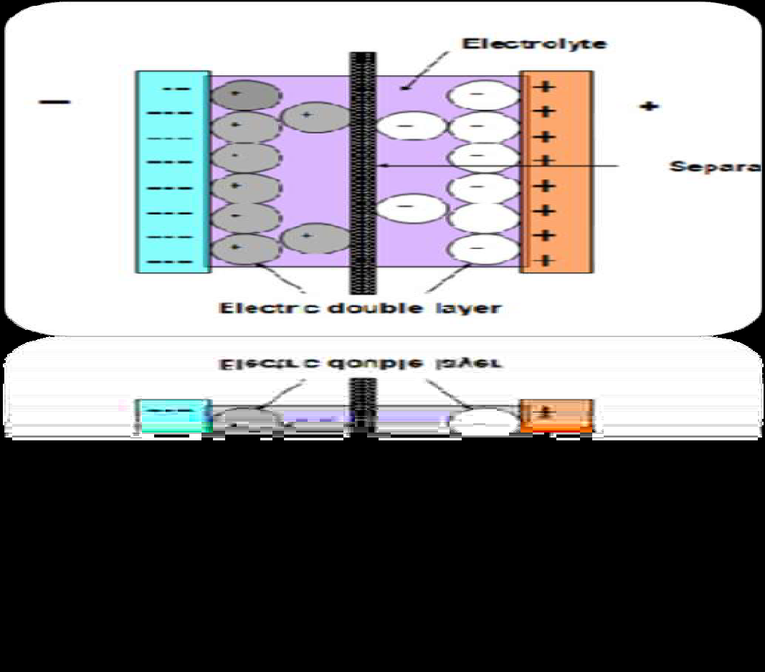
Introduction to super capacitors
The purpose of having separator is to prevent the charges moving across the electrodes.
The amount of energy stored is very large as compared to standard capacitor because of the enormous surface area created by the porous carbon electrodes and the small charge separation created by the dielectric separator.
The distance between the plates is in the order of angstroms.

Slide 35
SUPERCAPACITOR
 A supercapacitor is an electrochemical capacitor that has an very high energy density as compared to common capacitors, about 100 times greater.
 Supercapacitor is also known as Electric Double Layer Capacitor(EDLC) or Ultracapacitor.
 The capacitance range is From 100 Farad to 5K Farad

Slide 36
History of Super Capacitors
The Electric Double Layer Capacitor effect was first noticed in 1957 by General Electric.
In 1957 H. Becker developed a "Low voltage electrolytic capacitor with porous carbon electrodes".
Standard Oil of Ohio re-discovered this effect in 1966.
Standard Oil of Ohio gave the licensing to NEC, which in 1978 marketed the product as a “supercapacitor”.

Slide 37
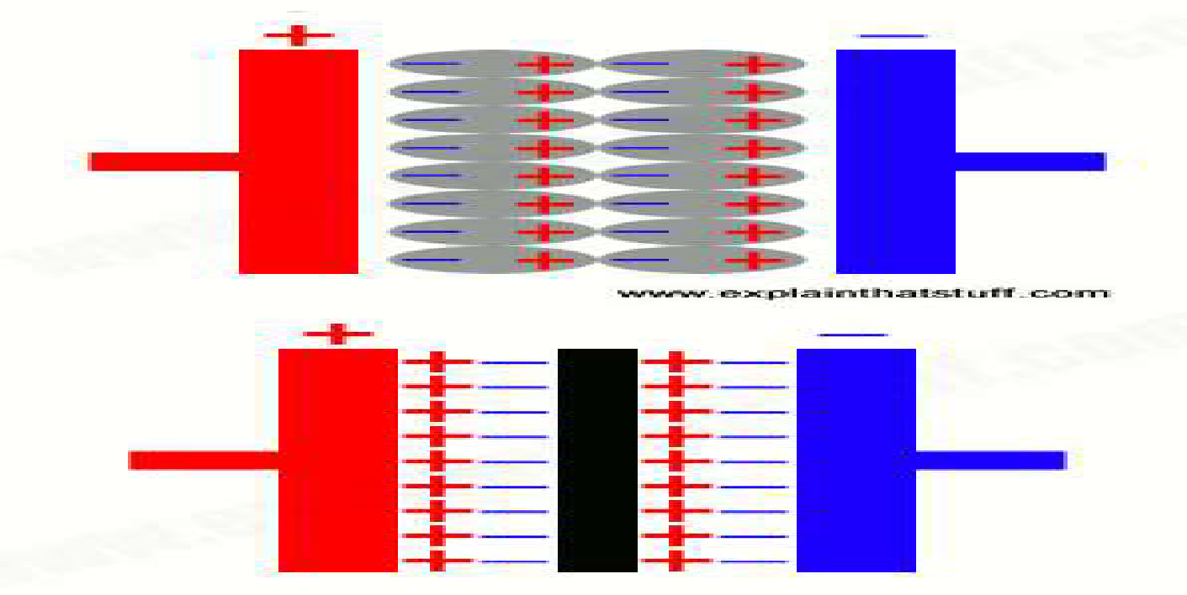

Basic Design
 Electrochemical capacitors (supercapacitors) consist of two electrodes separated by an ion permeable membrane (separator), and an electrolyte electrically connecting both electrodes. When the voltage is
applied, ions in the electrolyte form electric double layers of opposite polarity to the electrode's polarity.
 For example, positive electrodes will have a layer of negative ions and negative electrodes will have a layer of positive ions.

Slide 38
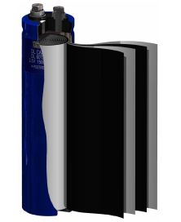
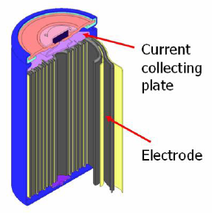
Super/Ultracapacitors

Slide 39
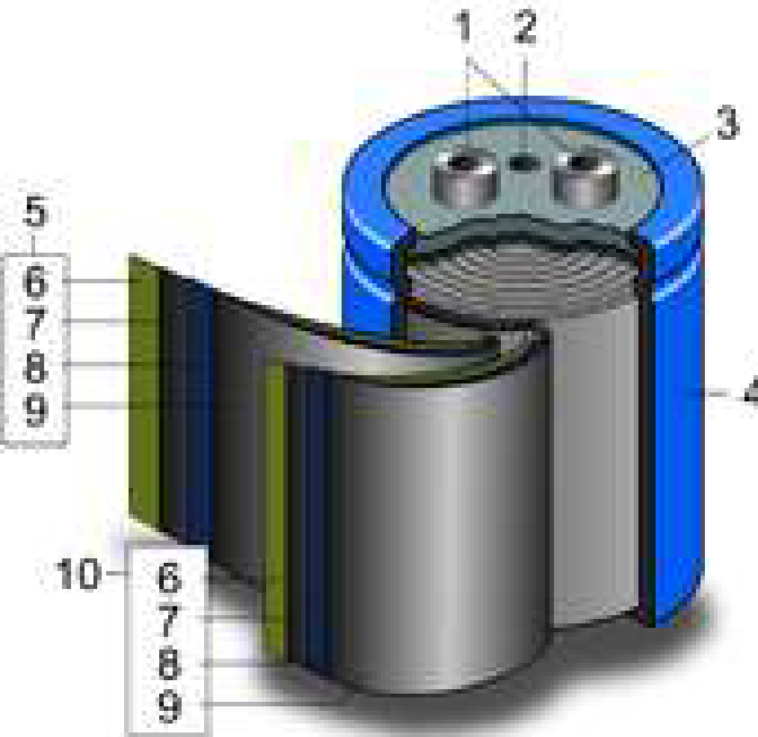
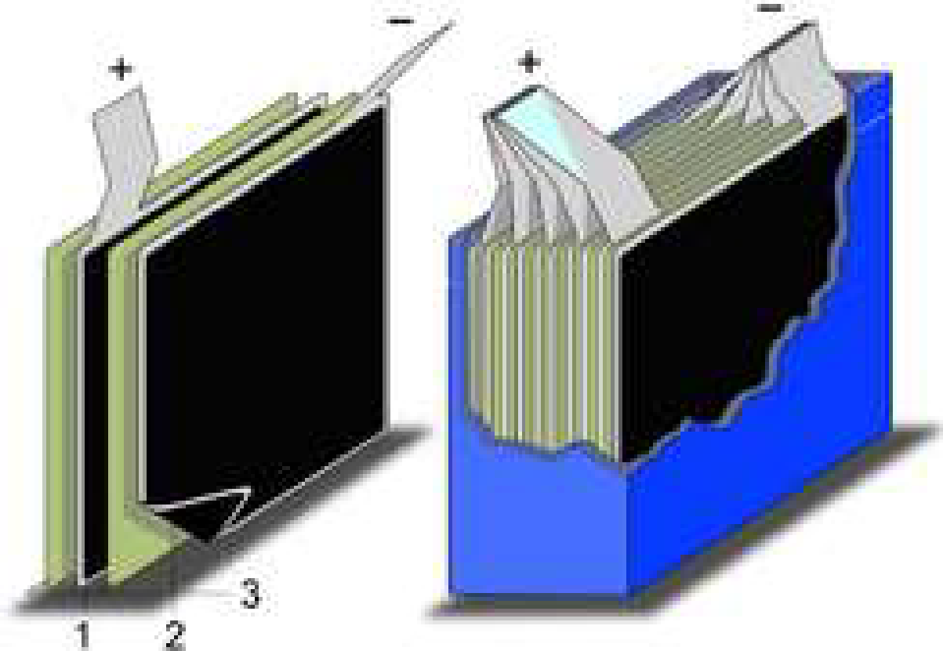
CONSTRUCTION
⚫ Supercapacitors are constructed with two metal foils, each coated with an electrode material such as activated carbon.
⚫ The electrodes are kept apart by an ion permeable membrane (separator) used as an insulator to protect the electrodes against short circuits.
⚫ The construction is subsequently rolled or folded into a cylindrical or rectangular shape and is packed in an aluminium can.
1.Positive electrode
2. Negative electrode
3. Separator
4.Aluminum can
5.Positive pole
6.Separator
7.Carbon electrode
8. Collector
9.Carbon electrode
10. Negative pole

Slide 40
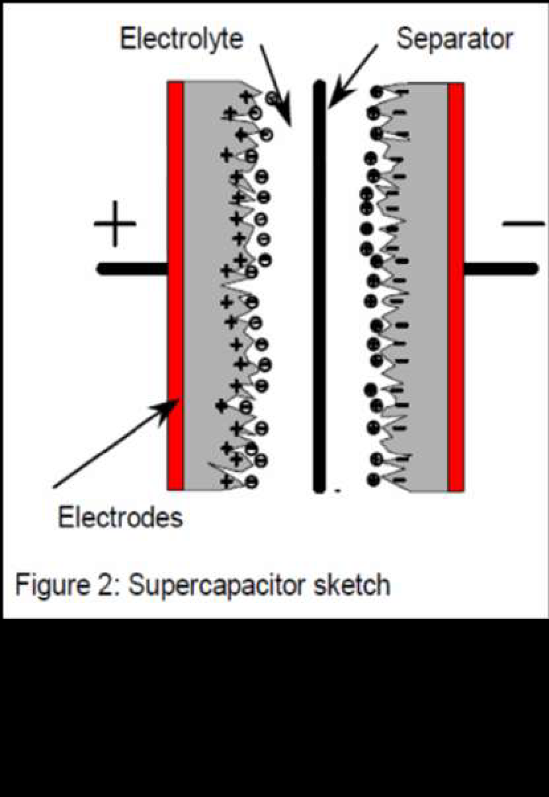
Cell Construction
An supercapacitor cell basically consists of two electrodes, a separator, and an electrolyte.
Electrodes are made up of a metallic collector, which is the high conducting part, and of an active material, which is the high surface area part.
The two electrodes are separated by a membrane, the separator, which allows the mobility of the charged ions but forbids the electronic conductance. Then the system is impregnated with an electrolyte.
Working voltage is determined by decomposition voltage of electrolyte and depends mainly on environment temperature, current intensity and required lifetime.

Slide 41
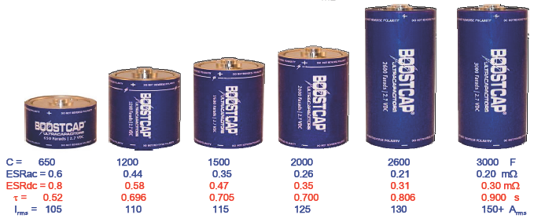
Super/Ultracapacitors
Some typical Maxwell’s ultracapacitor packages:
At 2.7 V, a BCAP2000 capacitor can store more than 7000 J in the volume of a soda can.
In comparison a 1.5 mF, 500 V electrolytic capacitor can store less than 200 J in the same volume.

Slide 42
ELECTRODES
⦿ Electrochemical inert materials with the highest specific surface area are utilized for electrodes in order to form a double layer with a maximum number of electrolyte ions.
⦿The main difficulties are to find cheap materials, which are chemically and electrically compatible with the electrolyte.
⦿As high surface active materials, metal oxides, carbon and graphite are the most interesting.
⦿Capacitors for high energy applications require electrodes made of high surface area activated carbon with appropriate surface and pore geometry. The electrode capacitance increases linearly with the carbon surface area.

Slide 43
ELECTROLYTE
⦿The electrolyte may be of the solid, organic or aqueous type.
⦿Organic electrolytes are produced by dissolving quaternary salts in organic solvents. Their dissociation voltage may be greater than 2.5 V.
⦿Aqueous electrolytes are typically KOH or H2SO4, presenting a dissociation voltage of only 1.23 V.
⦿As a consequence of the quadratic dependence of the energy density of the capacitor on the capacitor‟s voltage use of an organic electrolyte would be desirable.
⦿However, if power density is important, the increase in the internal resistance (ESR) due to the lower electrolyte conductivity has to be considered as well.

Slide 44
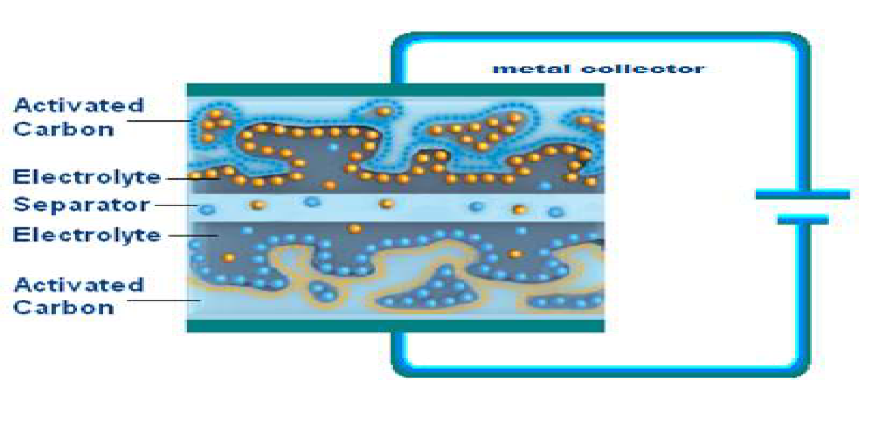
WORKING OF SUPERCAPACITOR
⚫ In a supercapacitor, there is no conventional dielectric. Both plates are soaked in an electrolyte and separated by a very thin insulator. When the plates are charged, an opposite charge forms on either side of the separator, creating what's called an electric doublelayer. This is why supercapacitors are often referred to as double-layer capacitors

Slide 45
WORKING OF SUPERCAPACITOR

Slide 46
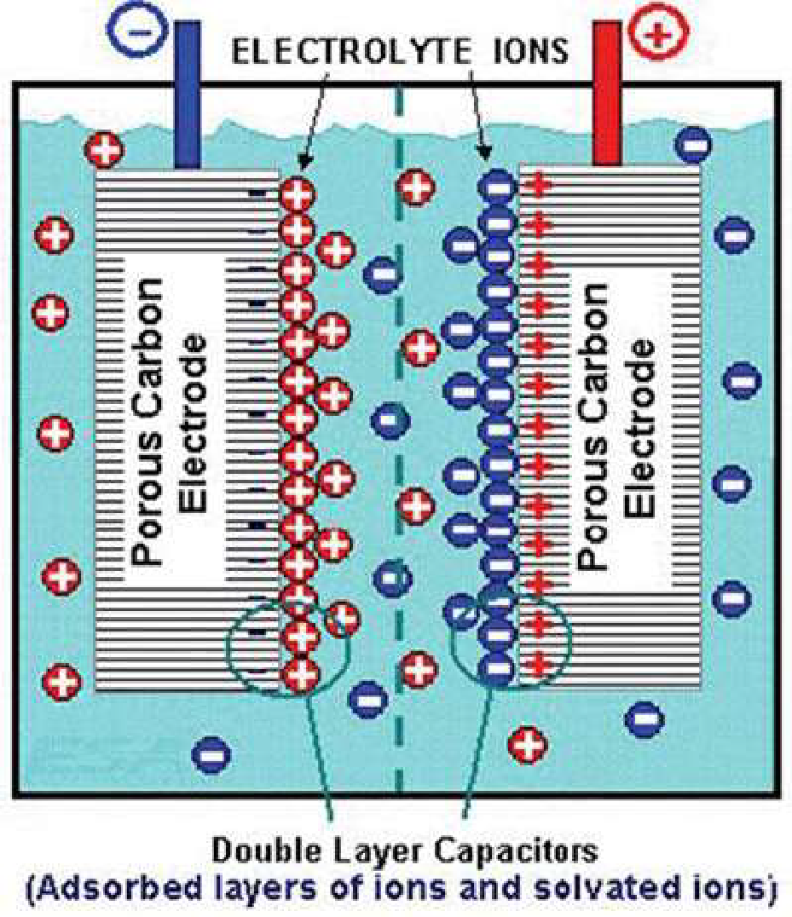
ELECTRIC DOUBLE LAYER
⚫ Electrochemical capacitor has two electrodes,
separated by a separator, which are electrically
connected to each other via the electrolyte.
⚫ When voltage is applied, and plates get charged, an
opposite charge forms on the either side of the
separator creating a electric double layer.

Slide 47
Materials/technologies used
TECHNOLOGY USED
⚫ Carbon nano tubes, carbon aerogels are used for supercapacitors plates or electrodes.
⚫ Sodium perchlorate (NaClO4) or lithium perchlorate (LiClO4) are used as electrolytes.
⚫ Polyacrylonitrile(C3H3N)n is used as a separator(thickness 0.3-0.8 nm).
⚫ Aluminium as a packing component.
Why these materials are taken
⚫ Electrodes:-
1)Carbon nanotubes greatly improve capacitor performance, due to the highly wettable surface area and high conductivity. 2)Highly porous.
⚫ Electrolytes:-
1) Wide working temperature (-90⁰c to 400⁰c). 2) Non flammable and low toxic. 3)Non-corrosive to electrode & packing components.
⚫ Separator:-
1) Unique tensile strength (103MegaPascals). 2)Electrical conductivity (1.5x104 S/m). 3)Not degraded easily.

Slide 48
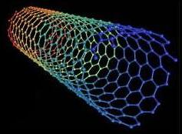
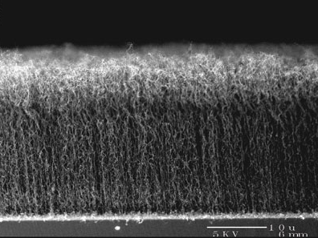
Materials used
Carbon Nanotubes
Approximately 1/50,000th the width of a human hair
Strongest and stiffest material on earth (>300 X Steal)
Low density
Semiconductor

Slide 49
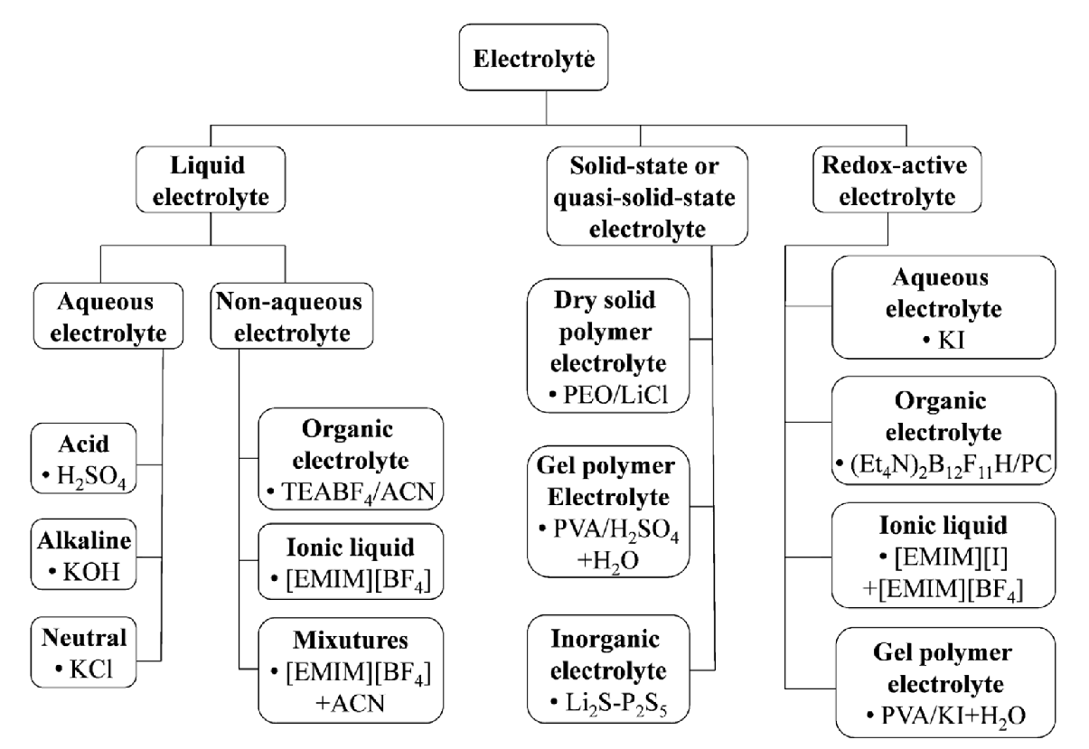
Electrolytes for electrochemical supercapacitors

Slide 50
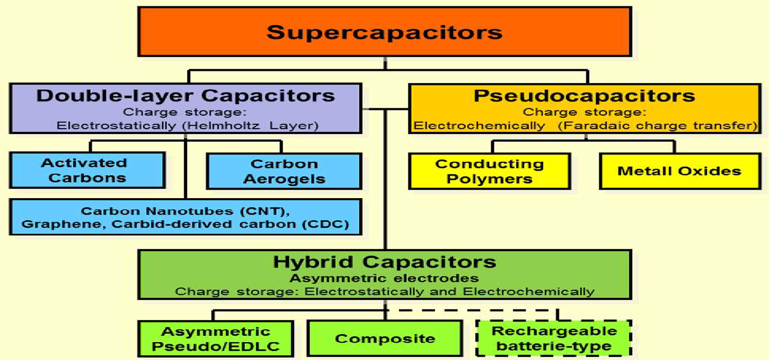
Types of Supercapacitors

Slide 51
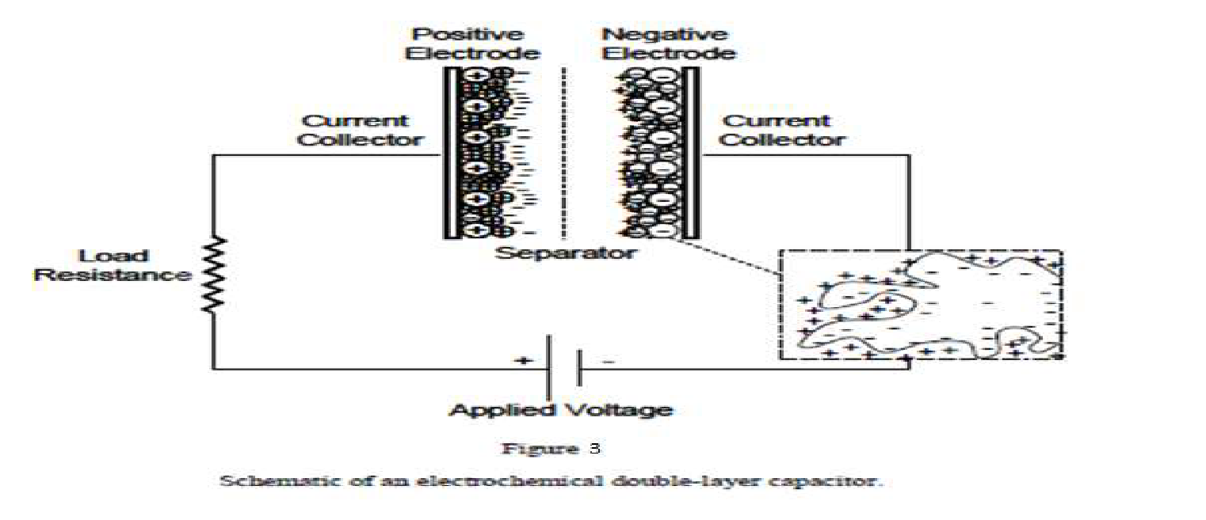
ELECTROCHEMICAL DOUBLE-LAYER CAPACITORS
⦿ Electrochemical double-layer capacitors (EDLCs) are constructed from two carbon-based electrodes, an electrolyte, and a separator.

Slide 52
EDLCs(Contd..)
EDLCs store charge electrostatically and there is no transfer of charge between electrode and electrolyte.
EDLCs utilize an electrochemical double-layer of charge to store energy. As voltage is applied, charge accumulates on the electrode surfaces.
These achieve very high cycling stabilities.
The subclasses of EDLCs are distinguished primarily by the form of carbon they use as an electrode material.
Different forms of carbon materials that can be used to store charge in EDLC electrodes are activated carbons, carbon aerogels, and carbon nanotubes.

Slide 53
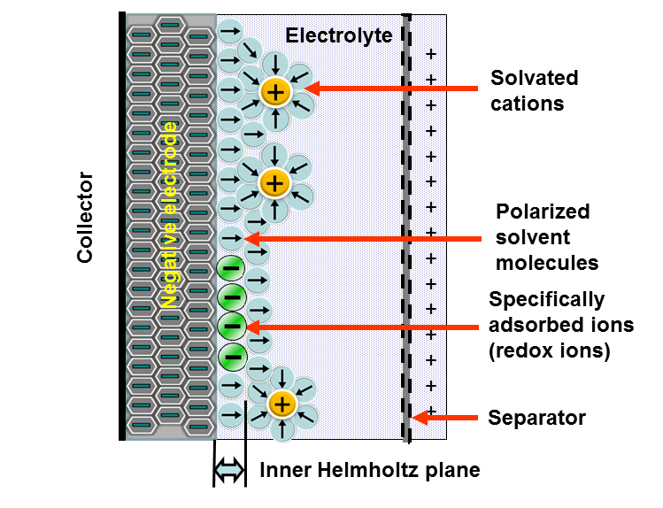
Pseudo Capacitor

Slide 54
PSEUDOCAPACITORS
In contrast to EDLCs, which store charge electrostatically,
pseudocapacitors store charge Faradically through the transfer of charge between electrode and electrolyte. This is accomplished through reduction-oxidation reactions.
Faradic processes may allow pseudocapacitors to achieve greater capacitances and energy densities than EDLCs. There are two electrode materials that are used to store charge in pseudocapacitors, conducting polymers and metal oxides.

Slide 55
HYBRID CAPACITORS
Hybrid capacitors attempt to exploit the relative advantages and mitigate the relative disadvantages of EDLCs and pseudocapacitors to realize better performance characteristics.
Utilizing both Faradic and non-Faradic processes to store charge, hybrid capacitors have achieved energy and power densities greater than EDLCs without the sacrifices in cycling stability and affordability that have limited the success of pseudocapacitors.
Research has focused on three different types of hybrid capacitors, distinguished by their electrode configuration: composite, asymmetric, and battery-type respectively.

Slide 56
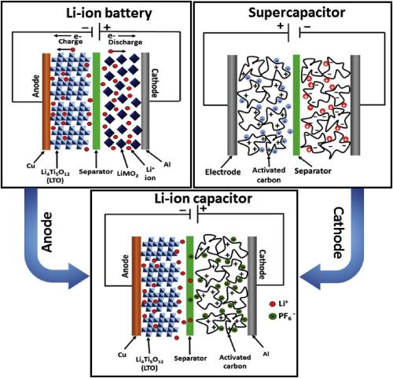
HYBRID CAPACITORS

Slide 57

HYBRID CAPACITORS

Slide 58

Asymmetric capacitor

Slide 59

Advanced asymmetric capacitor

Slide 60

COMPARISON WITH BATTERIES

Slide 61
Rechargeable Batteries Vs. Supercapacitors
Supercapacitors:
Higher power density
Much faster charge and discharge rate
Environmentally friendly
Extremely low internal resistance or ESR
High efficiency (97-98%)
Over a million charge-discharge cycles
Batteries:
Have higher energy density
Typically 200–1000 charge-discharge cycles
Contain highly reactive and hazardous chemicals
Negatively effected by low temperatures

Slide 62
ADVANTAGES of super capacitor
⚫ High energy storage.
⚫ Wide working temperature(-400c to 600c).
⚫ Eco-friendly.
⚫ Quick charging time.
⚫ Maximum life cycle.
⚫ High cycle efficiency (95%).
⚫ High specific power up to 17 kW/kg.
⚫ Extremely low internal resistance.
⚫ Safe.

Slide 63
Limitations of super capacitor
 Low energy density; usually holds 1/5 – 1/10 of a battery.
 Cannot use the full energy spectrum for some applications.
 The voltage varies with the energy stored.
 Have high self-discharge rate.
 Individual cells have low voltages, and so serial connections are needed to obtain higher voltages.
 Requires expert electronic control.
 Cannot be used in AC and high frequency circuits.
 High cost.

Slide 64




Applications for Supercapacitors
Back up for uninterruptable power supplies (UPS)
Light weight power supplies for small aircraft
Provide short duration power for various vehicle systems such as breaking or steering
Used to absorb power during short periods of generation such as Regenerative Braking
Extend range and battery life in Hybrid Electric Vehicles (HEV)

Slide 65

Hybrid Electric Vehicles
The CSIRO in Australia [national science agency] has developed the UltraBattery, which combines a supercapacitor and a lead acid battery in a single unit
4x longer life cycle, 50% more power, 70% cheaper than batteries used in HEV’s

Slide 66
APPLICATIONS
⚫ In start up mechanism for Automobiles.
⚫ Used in Diesel engine start up in submarines & tanks.
⚫ China is experimenting with a new form of electric bus that runs without powerlines but runs on power stored in large supercapacitors, which are quickly recharged whenever the electric bus stops at any bus stop, and get fully charged in the terminus. A few prototypes were being tested in Shanghai in early2005. In 2006two commercial bus routes began to use supercapacitor buses, one of them is route 11 in Shanghai.
⚫ Backup power system in missiles.
⚫ Power source for laptops, flash in cameras.
⚫ Voltage stabilizer.

Slide 67
APPLICATIONS
To deliver high power and bridge power gaps
Industrial and electronic applications
Used in wind turbines, electric and hybrid vehicles
Regenerative braking to release the power in acceleration
To start power in start-stop systems
Regulate voltage in the energy grid
To capture and assist the power in lower loads and lifted loads
Back-ups the power in a quick discharging state.

Slide 68

Bus operated on Supercapacitor in Shanghai

Slide 69


Supercapacitor installed in bus Supercapacitors

Slide 70

Classification of solar cells
‹#›

Slide 71


Silicon
Shared electrons
Si
Si
Si
Si
Si
Si
Si
Si
-
Si
Silicon is group IV element – with 4 electrons in their valence shell.
When silicon atoms are brought together, each atom forms covalent bond with 4 silicon atoms in a tetrahedron geometry.
Notes:
‹#›

Slide 72
n-type Doping
Conducting band, E_{c}
Si
Si
Si
Extra
E_{d} ~ 0.05 eV
Electron
Si
As
Si
E_{g} = 1.1 eV
Si
Si
-
Si
Valence band, E_{v}
Doping silicon lattice with group V elements can creates extra electrons in the conduction band — negative charge carriers (n-type), As- donor.
Doping concentration #/cm³ (10¹⁶/cm³ ~ 1/million).
Notes:
‹#›

Slide 73
p-type doping
Conducting band, E_{c}
Si
Si
Si
Hole
E_{g} = 1.1 eV
Si
B
Si
E_{a} ~ 0.05 eV
Si
Si
-
Si
Valence band, E_{v}
Electron
Doping silicon with group III elements can creates empty holes in the conduction band — positive charge carriers (p-type), B-(acceptor).
Notes:
‹#›

Slide 74


p-n Junction (p-n diode)
p
n
I
V
i
R O F
depletion layer
p
n
p
n
V<0
- +
V>0
V>0
V<0
Reverse bias Forward bias
A p-n junction is a junction formed by combining p-type and n-type semiconductors together in very close contact.
In p-n junction, the current is only allowed to flow along one direction from p-type to n-type materials.
Notes:
‹#›

Slide 75


Construction of amorphous silicon solar cells
A typical silicon solar cell consists of n-type material (Phosphorus doped silicon) and a p-type (Boron doped silicon) material made of silicon.
In the fabrication of device these n-type and p-type materials are joined to form a p-n junction.
On top of n type connecting front electrodes are placed.
The metal back contact is attached to p-type layer.
An antireflective coating is filled in between the front electrodes to avoid the reflection of sunlight.
Finally p-type and n-type layers are joined externally to the circuit.
The complete solar cells are sealed to avoid the environmental contact.
Notes:
‹#›

Slide 76

Working of silicon solar cells
When sunlight is incident on solar cells photon strikes on p-n junction.
Then electron hole pair will be created at the junction by the absorption of photon.
This electron hole pair diffuses towards respective layer based on affinity.
The electrons diffuse towards n-type later and holes are diffused towards p-type layer.
These layers are connected externally through a circuit, hence current will be generated.
Notes:
‹#›

Slide 77
Advantages of silicon solar cells
Solar cell is renewable energy which can be continuously drawn from the sun.
It is cost effective energy because once it installed there will be minimum maintenance charges for small usage.
Solar energy is environment friendly and green energy because it doesn’t produce any greenhouse gasses and no pollutants.
It doesn’t involve any combustion reaction or radioactive residue hence no pollution.
Notes:
‹#›

Slide 78
Dis-advantages of silicon solar cells
Space utilization: Solar cells required large area for installation.
It requires high investment cost for a big power plant.
During the rainy season power production is less hence grid maintenance will be difficult.
Solar energy is produced only in the day time hence storage will be a big challenge.
Notes:
‹#›

Slide 79


Organic photovoltaics
‹#›

Slide 80

Working mechanism of organic photovoltaics
‹#›

Slide 81
Working mechanism of organic photovoltaics
Step 1. Exciton generation: Upon illumination of the active material, an electron is excited to the LUMO by absorption of a photon with energy larger than the HOMO-LUMO gap (band gap). The light absorption will generate electron-hole pairs, so-called excitons, where the electron and the hole are attracted to each other and bounded by Coulomb forces.
Step 2. Exciton diffusion: The generated exciton can diffuse through the material to the donor-acceptor interface. Due to the short lifetime of the exciton in organic materials, the exciton diffusion length is in order of 10 nm.
Step 3. Exciton dissociation: If the exciton reaches the donor-acceptor interface within its lifetime, it dissociates into a free electron and hole due to the local electric fields caused by an energy level offset between the two materials.
Step 4. Charge carrier transport: Free charge carriers are transported to the electrodes through the donor and acceptor material by an internal electric field caused by electrodes with different work functions. The electrons are collected at the cathode and the holes at the anode.
‹#›

Slide 82


Organic photovoltaics
‹#›

Slide 83

Synthesis of 3 hexyl thiophene
‹#›

Slide 84

Dye sensitized solar cells
‹#›

Slide 85


Dye sensitized solar cells
Michael Grätzel
‹#›

Slide 86

Quantum Dot sensitized solar cells
‹#›

Slide 87
Fabrication of the device
It consists of two electrodes cathode and anode generally cathode is made of graphite or platinum.
Anode is made of transparent conducting oxide such as Indium tin oxide. Anode is coated with a layer of nano porous materials (TiO₂ of ZnO).
Further these nano porous materials are coated with light absorbing organic/inorganic dye molecules/quantumdots.
The nano-porous materials acts as photo-sensitizer also it provides road way for electrons.
A triiodide electrolyte system is employed in between the electrodes, which helps in electron transfer process.
‹#›

Slide 88
Mechanism of working
When light strikes the solar cell it passes through ITO layer and it reaches the dye molecule.
Once the photon hits the quantum dot, it undergoes excitation with the liberation of electron, which travels through the network TiO₂ nanoparticles and finally it reaches to cathode.
The cell is completely filled with Triiodide electrolyte.
The electron from the cathode directly reduces the triiodide molecule to iodide molecules.
Further this iodide molecule reaches the quantumdot oxidizes to form triiodide again with the liberation of electrons, which can be easily absorbed by dye molecules.
And similar cycle continues whenever sunlight falls on the solar cells.
‹#›

Slide 89

Advantages and disadvantages of
Dye Sensitized Solar Cells
‹#›

Slide 90

Hydrogen energy
Why hydrogen ?
Clean – no greenhouse gases
Energy security – can be produced from abundant sources
Economic growth
Efficient – fuel cells ~75% efficiency
Portable: Car tanks, micro fuel cells…
Honda FCX Clarity

Slide 91

Hydrogen production

Slide 92

What is Photocatalytic water splitting?

Slide 93


Photo catalysts

Slide 94

Photocatalytic water splitting: Mechanism

Slide 95

Mechanism of water splitting

Slide 96

Mechanism of water splitting

Slide 97

Mechanism of oxygen elimination

Slide 98

Photocatalytic water splitting: overview
OER catalyst
HER catalyst

Slide 99


Application of hydrogen in fuel cell vehicles

Slide 100

Application of hydrogen in fuel cell vehicles

Slide 101

Role of hydrogen in fuel cell vehicles

Slide 102

Advantages
(air quality, energy savings and health benefit)

Slide 103
Thank you
‹#›

